Slide 1
Web Vulnerabilities/Attacks

Slide 2
Three Main Things to Consider
Exploitability
Detectability
Impact or Damage
Notes:
what is needed to exploit the security vulnerability? Highest exploitability when the attack needs only web browser and lowest being advanced programming and tools
How easy is it to detect the threat? Highest being the information displayed on URL, Form or Error message and lowest being source code.
How much damage will be done if the security vulnerability is exposed or attacked? Highest being complete system crash and lowest being nothing at all.

Slide 3
Common Vulnerabilities

Slide 4
CSRF
Cross-Site Request Forgery forces an end user to execute unwanted actions on a web application where they’re currently authenticated.

Slide 5
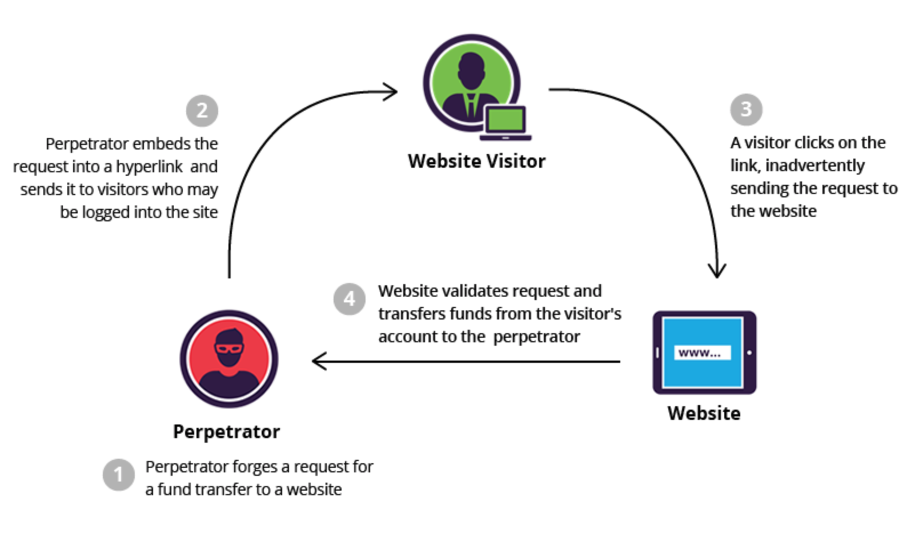
Notes:
CSRF attacks specifically target state-changing requests, not theft of data
With a little help of social engineering (such as sending a link via email or chat), an attacker may trick the users of a web application into executing actions of the attacker's choosing. If the victim is a normal user, a successful CSRF attack can force the user to perform state changing requests like transferring funds, changing their email address, and so forth. If the victim is an administrative account, CSRF can compromise the entire web application.
CSRF is an attack that tricks the victim into submitting a malicious request. It inherits the identity and privileges of the victim to perform an undesired function on the victim's behalf. For most sites, browser requests automatically include any credentials associated with the site, such as the user's session cookie, IP address, Windows domain credentials, and so forth. Therefore, if the user is currently authenticated to the site, the site will have no way to distinguish between the forged request sent by the victim and a legitimate request sent by the victim.

Slide 6
SQL Injection
A code injection technique, used to attack data-driven applications in which nefarious SQL statements are inserted into an entry field for execution.
https://www.youtube.com/watch?v=_jKylhJtPmI&t=348s
Notes:
SQL is a language that is used to communicate with a database. (e.g. where all those passwords are stored!)
SQL injection attacks allow attackers to spoof identity, tamper with existing data, cause repudiation issues such as voiding transactions or changing balances, allow the complete disclosure of all data on the system, destroy the data or make it otherwise unavailable, and become administrators of the database server.

Slide 7
Wanna Try it?
http://cs558web.bu.edu/sqlinject0/
Username: victim

Slide 8
DoS Attack
Denial of Service Attack
https://www.youtube.com/watch?v=BcDZS7iYNsA
Notes:
Not a vulnerability, but an attack.
a cyber-attack where the perpetrator seeks to make a machine or network resource unavailable to its intended users by temporarily or indefinitely disrupting services of a host connected to the Internet. Denial of service is typically accomplished by flooding the targeted machine or resource with superfluous requests in an attempt to overload systems and prevent some or all legitimate requests from being fulfilled.^{[1]}

Slide 9

Let’s try this too!

